Slide 1

Predicting HDB Resale Prices
Buck Hui koh

Slide 2
Problem Statement
Property prices in Singapore are exorbitant. How does an individual decide on the acceptable price to pay for a resale HDB property.
Most Singaporeans live in HDB (the Housing and Development Board) flats, which are heavily subsidised by the government.

Slide 3
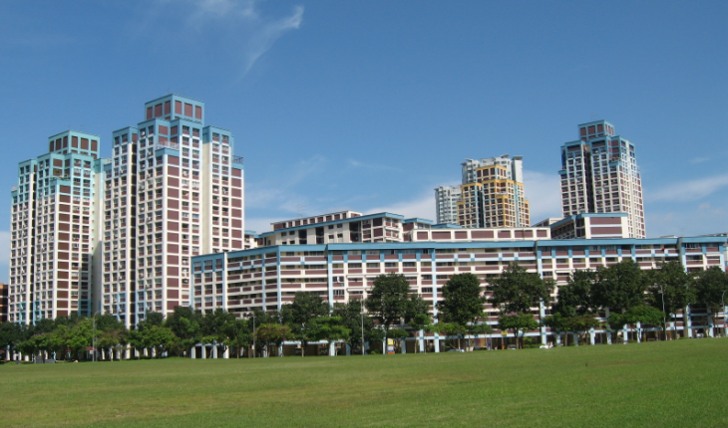
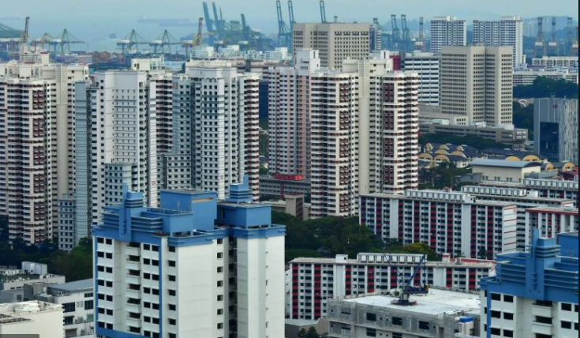
Picture of a Typical HDB Town
Source: Public housing in Singapore - Wikipedia
Source: The Straits Times

Slide 4
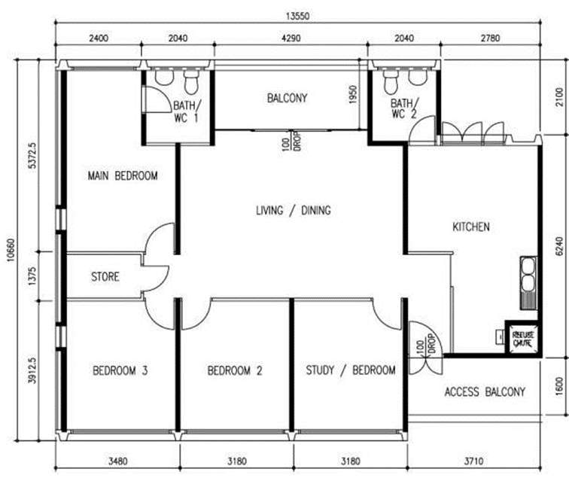
Floor Plan of a Typical 5-room Flat
There are varying flat sizes. This shows a typical 5-room unit, which is one of the larger units offered by the HDB.

Slide 5
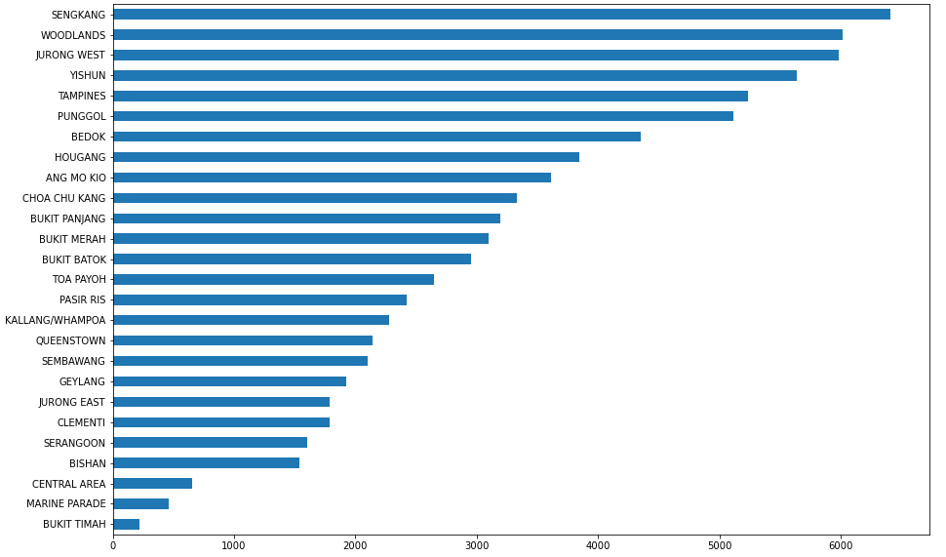
Overview of the Resale Market
Resale is spready across all the major towns, with younger towns being more active.

Slide 6
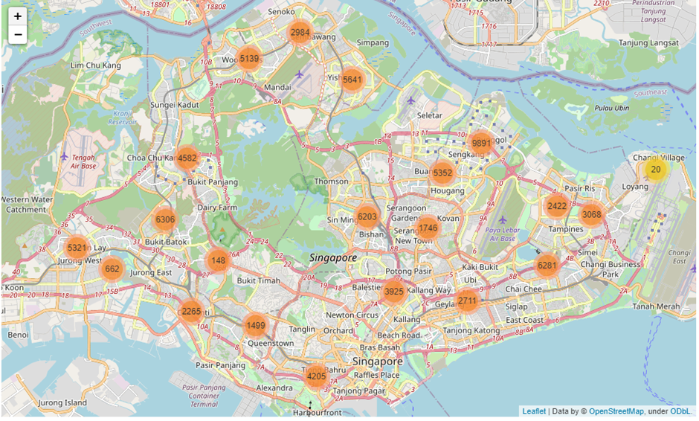
Mapped Perspective of Resale Market
Resale HDB is an active market.
Overview of sales over the last 3 years as shown by map on the right.

Slide 7
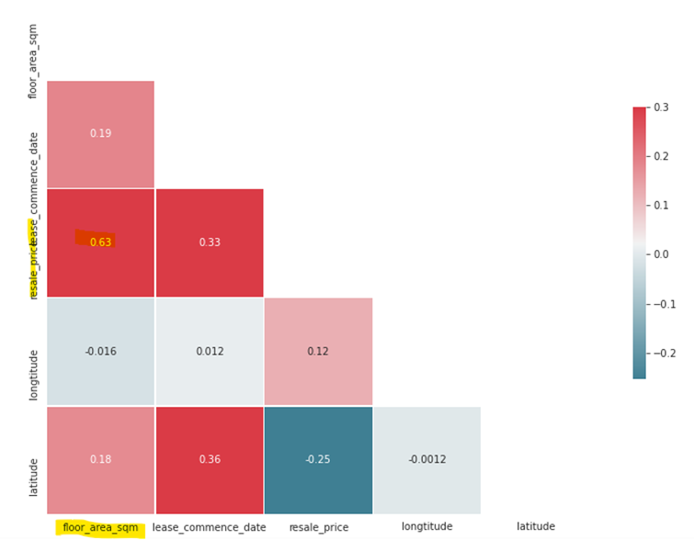
What affect Resale Prices
Correlation shows that resale price is more significantly affected by floor area.

Slide 8
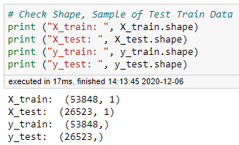
Methodology for Price Prediction
Using Sklearn linear model (for linear regression)
X-train, X-test, y_train, y_test split. Data shape as follows:

Slide 9
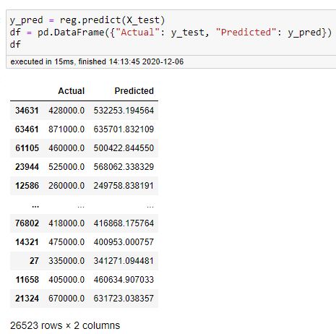
Actual and Predicted Scores
Close correlation between price and floor area. Predicted and actual values are fairly close.

Slide 10
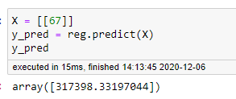
Final Prediction
Our client wants to buy a resale property of around 67 square meter. Using the model, the output is estimated at SGD317,398. Based on domain knowledge of the HDB resale market in Sengkang, this is a reasonable price range.

Slide 11

Conclusion
Model works. Nevertheless, as in all property transactions, the negotiation power of the buyer and seller, amongst other factors, have to be taken into account.
For example, if the seller is desperately trying to sell the property due to some economic hardship, the seller may be prepared to reduce the price to simply dispose off the property and get some needed cash.
Thank You

